Slide 1
Senior Married Couple
Michael Davenport

Slide 2
Senior Married Couple
This lesson will focus on a tax return for a typical retired senior married couple with no dependents
The following new tax topics* will be discussed:
  Income: Social Security, Pensions, Capital Gains, Rent (land), K-1 Income
  Itemized Deductions
  Miscellaneous: Identity Theft (IP PIN)
* This problem assumes that the Andrews, Baker and Caldwell problems have been completed already.
Tax topics introduced in those problems may appear in Davenport, but they will not be discussed again.

Slide 3
Senior Married Couple cont’d
Additional topics/practice on previously introduced topics:
  Recoveries (State Tax Refund, PTR and Homestead Benefit Recoveries)
    NJ Tax Refund Worksheet
    NJ Sales Tax Worksheet
* This problem assumes that the Andrews, Baker, and Caldwell problems have been completed already.
Tax topics introduced in those problems may appear in Davenport, but they will not be discussed again.

Slide 4
Basic Information
Michael Davenport

Slide 5
Scenario Step 0
Basic Information

Slide 6
Five Choices for Filing Status
See information in Caldwell problem on determining filing status
Single
Married Filing Jointly (MFJ) – used for Davenport problem
Married Filing Separately (MFS)
Head Of Household (HOH)
Qualified Widow(er) (QW)

Slide 7
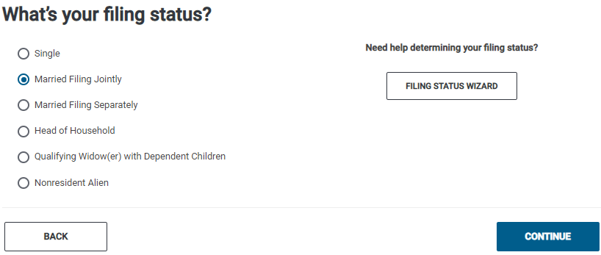
TSO – Entering Filing Status
Basic Information>Filing Status
MFJ filing status

Slide 8
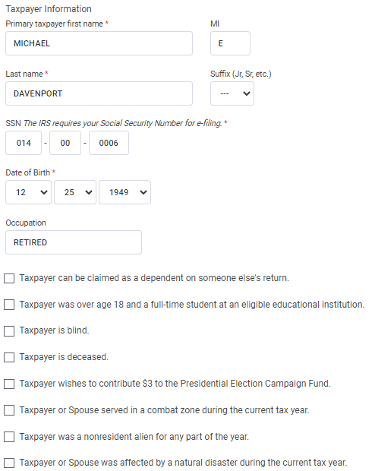
TSO – Entering Personal Information for Michael Davenport
Basic Information>Personal Information
See Andrews problem
for information on
completing Personal
Info screens

Slide 9
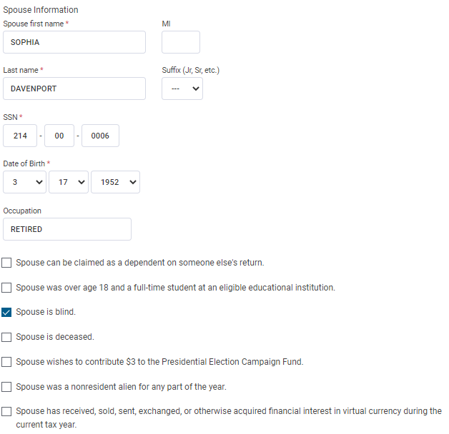
TSO – Entering Personal Information for Michael Davenport
Basic Information>Personal Information
cont’d
Legally blind:
Cannot see better
than 20/200 in better
eye even with correction
OR field of vision not
more than 20 degrees
Sophia is eligible for extra standard deduction
amount since she is
legally blind
Blindness flows to NJ 1040
for extra exemption; only
need NJ Checklist entry for
disability other than blind

Slide 10
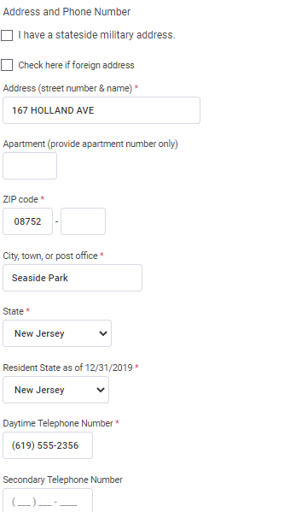
TSO – Entering Personal Information for Taxpayer and Spouse
Basic Information>Personal Information
cont’d

Slide 11
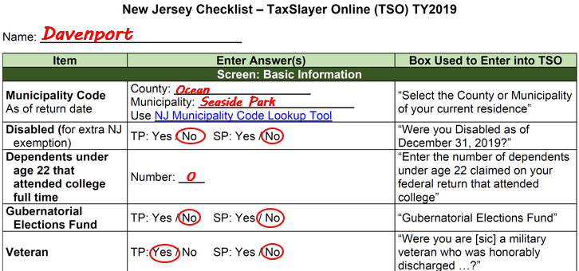
Enter Additional Personal Info on NJ Checklist
Blindness flows to NJ 1040
for extra exemption; only
need NJ Checklist entry for
disability other than blind
Military veteran entitled
to extra $6,000 exemption

Slide 12
Dependents
The Davenports do not have any dependents
  Answer NO to TSO question about dependents

Slide 13
TSO - Student Activity
Pause the slide show
Enter the filing status, personal information and dependency information for Michael and Sophia Davenport into TSO (Step 0)

Slide 14
Income
Michael Davenport

Slide 15
Scenario Step 1
Social Security

Slide 16
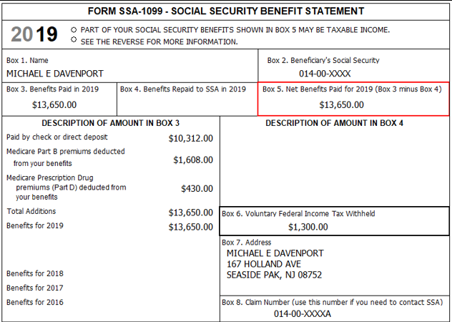
Form SSA-1099
Medicare premiums
can be claimed on
Schedule A
Amount to use for SS
income
Federal tax withheld

Slide 17
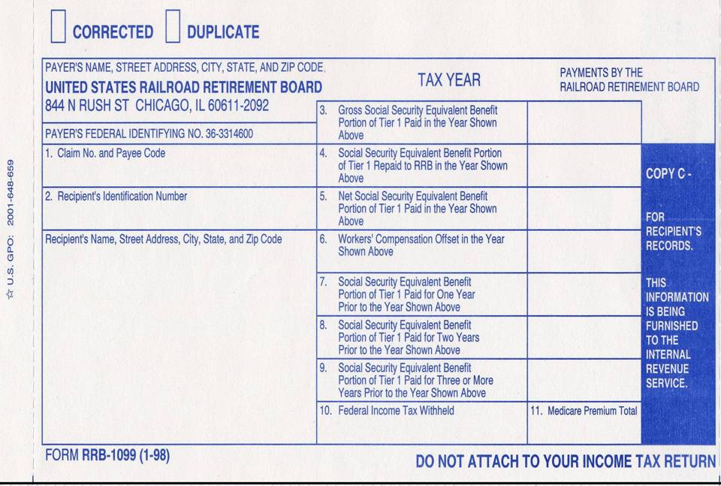
Form RRB-1099 Railroad Retirement Benefits (RRB) Tier 1 - Equivalent to Social Security
Does not pertain
to Davenport;
just for illustration
$13,650
Douglas Davis
210 Main Street
Bridgewater, NJ 08807
Enter on Social Security screen
$1,300
Notes:
17

Slide 18
Taxability of Social Security (SS) and RRB – Tier I on Federal Return
A taxpayer can have SS income as:
  A retirement benefit (most common)
  A disability benefit
  A survivor benefit (parent (rare)/spouse/children)
Taxability of Social Security depends on “combined income”
  “Combined income” = ½ of SS + other income on return (including tax-exempt interest)
  For MFJ, if “combined income” is:
    Less than $32,000 0% of SS is taxable
    Between $32,000 - $44,000 up to 50% of SS is taxable
    $44,000+ up to 85% of SS is taxable

Slide 19
Taxability of Social Security (SS) on Federal Return
cont’d
  For S, HOH, QW and MFS (only if spouses lived apart all year), if “combined income” is:
    Less than $25,000 0% of SS is taxable
    Between $25,000 - $34,000 up to 50% of SS is taxable
    $34,000+ up to 85% of SS is taxable
  For MFS (if spouses lived together at any time during tax year), if “combined income” is:
    $0 up to 85% of SS is taxable
TSO automatically calculates taxable amount of SS
Medicare premiums can be claimed as medical expenses on Schedule A
  TSO automatically includes in Schedule A medical total; premiums do not show on Medical Expenses screen itself

Slide 20
Taxability of Social Security (SS) and RRB on NJ Return
NJ does not tax SS or RRB benefits (Tier 1 or 2)
  Do not appear on NJ 1040 at all
  TSO handles automatically; no NJ Checklist entry needed
Supplemental Security Income (SSI) is not taxable on Federal or NJ; no tax document issued

Slide 21
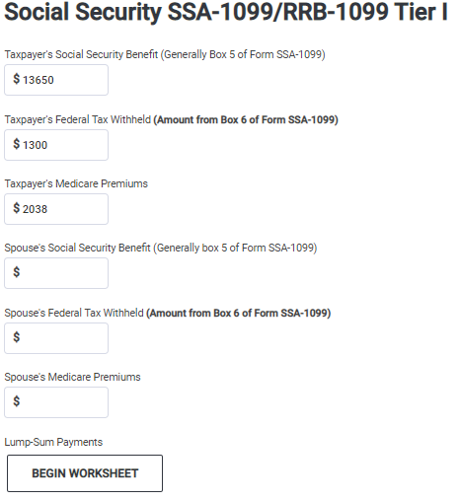
TSO - Entering SS for Michael Davenport
Federal Section>Income>IRA/Pension Distributions (1099-R, 1099-SSA)>Social Security Benefits/RRB-1099
From SSA-1099 Box 5
From SSA-1099 Box 6
Use a scratch pad to total and
document Medicare Part B and
D premiums

Slide 22
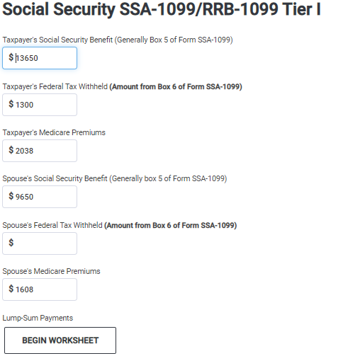
TSO - Entering SS for Sophia Davenport
Federal Section>Income>IRA/Pension Distributions (1099-R, 1099-SSA)>Social Security Benefits/RRB-1099
Sophia’s info from SSA-1099

Slide 23
TSO - Student Activity
Pause the slide show
Enter the SSA-1099 statements for both Michael and Sophia Davenport into TSO (Step 1)
Check the Federal and NJ refund monitors

Slide 24
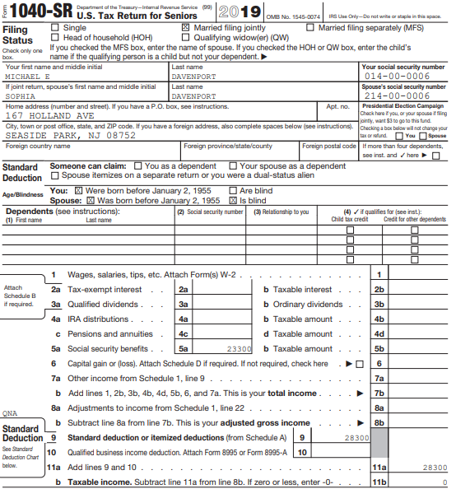
TSO – SS on Federal 1040
SS not taxable for NJ;
does not appear at all on
NJ 1040
No taxable SS amount since
“combined income” (½ of SS +
all other income) is not greater
than $32,000;
Could change later as more
income is added to return
Total amount of SS income
for Michael and Sophia

Slide 25
Scenario Step 2
1099-R Defense Finance & Accounting Service

Slide 26
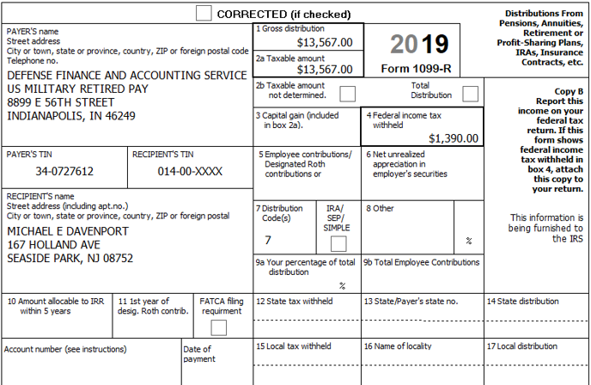
Form 1099-R Military Pension
Gross distribution
Issuer for all
military pensions
Taxable amount
Federal tax withheld
Distribution code

Slide 27
Military Pension
Issuer is always Defense Finance and Accounting Service
Military pension does not have to be counted as a distribution in calculation of retirement savings credit
  See Andrews problem and Pub 4012 Page G-16 for more details
  Check box below Box 2a on 1099-R screen that says “Does not carry to Form 8880”
Military pension is not reportable or taxable on NJ return
  Requires a NJ Checklist entry in Income Subject to Tax section since 1099-R income flows from Federal to NJ return
  Enter as a negative amount to subtract from NJ pension income on NJ 1040 Line 20a
  Do not enter as an adjustment to NJ 1040 20b for Excludable Amounts of IRAs, Pensions and Annuities

Slide 28
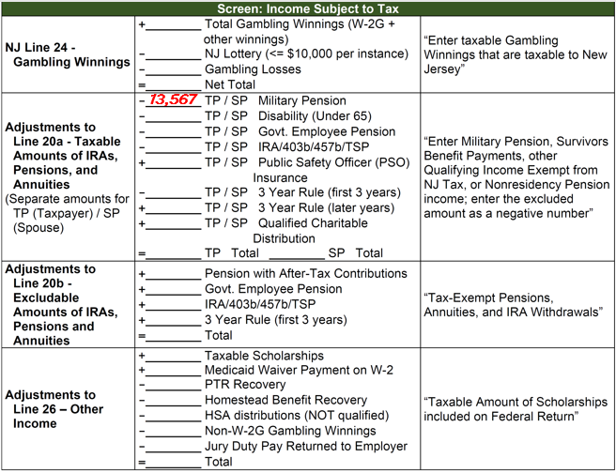
Military Pension on NJ Checklist
Military pension
entered as a
negative amount

Slide 29
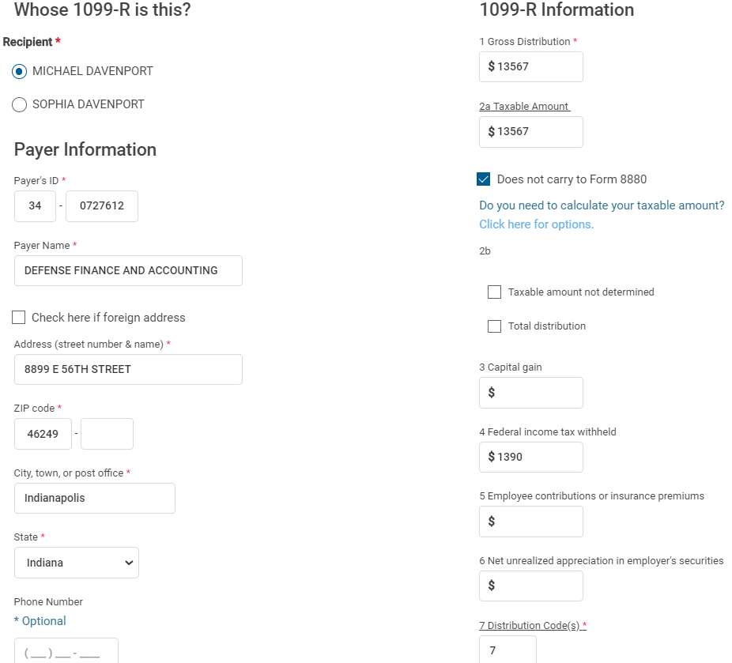
TSO - Entering 1099-R for Defense Finance and Accounting Service
Federal Section>Income> IRA/Pension Distributions >Add or Edit a 1099-R
Enter gross distribution;
TSO populates taxable amount;
correct if necessary
Does not carry to Form 8880 for
Retirement Savings Credit
Federal tax withheld
N
Normal distribution

Slide 30
TSO - Student Activity
Pause the slide show
Enter the 1099-R from Defense Finance and Accounting Service into TSO (Step 2)
Check the Federal and NJ refund monitors

Slide 31
Scenario Step 3
1099-R Calvert County Sheriff’s Department

Slide 32
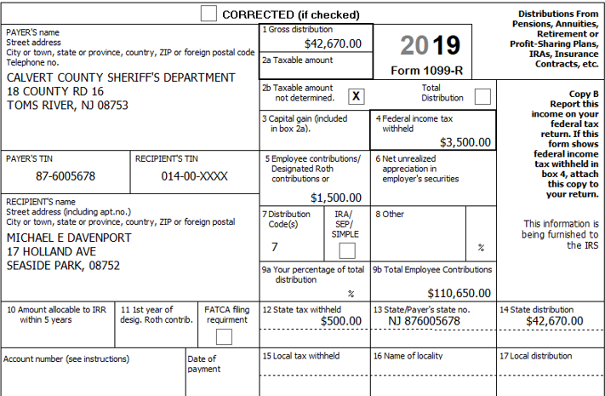
Form 1099-R Calvert County Sheriff’s Department
Gross distribution
Taxable amount
not determined
PSO health insurance
Total employee contributions
State tax withheld

Slide 33
Tax Topics on Calvert County 1099-R Not on Previous 1099-Rs
Boxes 2a Taxable amount and Box 2b Taxable amount not determined
  Refer to Pub 4012 Page D-39 code 7
  Box 2a is blank, Box 2b taxable amount not determined is checked, there is an amount in Box 9
  Counselor needs to determine the amount of distribution that is taxable
  Use Bogart Annuity calculator on TP4F Preparer page to determine correct taxable amount
    Simplified General Rule
If an amount is given in Box 2a as the Taxable amount, use that amount even if
Box 2b is checked for Taxable amount not determined; do not use Bogart calculator

Slide 34
Tax Topics on Calvert County 1099-R Not on Previous 1099-Rs
cont’d
Box 5 – Must probe with taxpayer because can contain multiple different pieces of information. Most common:
  Nontaxable portion of distribution due to after-tax contributions made to retirement plan
    Box 5 + Box 2a = Box 1
    Just enter amounts given into correct boxes; TSO handles automatically
  Health insurance premiums (on civil service pensions – Form CSA 1099-R or CSF 1099-R)
    Enter in Box 5 and also enter as medical expenses on Schedule A

Slide 35
Tax Topics on Calvert County 1099-R Not on Previous 1099-Rs
cont’d
  Cost of health insurance premiums for a Public Safety Officer (PSO) – this is the case for Davenport
    PSO includes police/law enforcement officer, firefighter, chaplain, or member of rescue squad/ambulance crew
    See next slide for additional detail
Box 9 – Total employee contributions
  May exclude part of these contributions from taxation each year over your expected lifetime
  Used in Bogart Annuity calculator tool

Slide 36
PSO Health Insurance Rules
Refer to Pub 4012 Page D-35 and NJ Special Handling document
Taxpayer who is PSO may exclude health insurance premiums paid out of pension from taxation
  Maximum exclusion of $3,000
  Reduce 1099-R Box 2a Taxable Amount by PSO insurance premium amount, not to exceed $3,000
  If premiums are excluded from taxable amount on 1099-R, they cannot also be claimed as medical expenses on Schedule A or as health insurance for the self-employed health insurance deduction

Slide 37
PSO Health Insurance Rules
cont’d
    Excess above $3,000 can be claimed as medical expense on Schedule A or as self-employed health insurance deduction
  Premiums must be paid directly from pension to insurer
  Can be for health or long-term care insurance
  Must be retired due to age or disability
  Not available to surviving spouse or dependent after PSO dies

Slide 38
PSO Health Insurance Premiums on NJ Checklist
PSO health insurance premiums are excluded from taxable pension amount on Federal 1040
  Cannot be claimed as medical expenses on Schedule A
PSO premiums are not excluded from NJ taxable pension amount on NJ 1040
  Must add back PSO insurance premiums to NJ taxable pension on Line 20a
    Enter as positive amount on Adjustment to Line 20a on NJ Checklist in Income Subject to Tax section
  Can be included as medical expenses on NJ 1040 Line 31
    Enter as positive Pre-Tax (Federal) / Post-Tax (NJ) Medical amount on NJ Checklist in Subtractions from Income Tax section

Slide 39
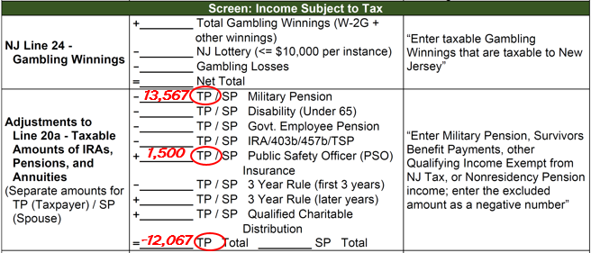
PSO Insurance Premiums Added to Taxable Pension on NJ Checklist
PSO insurance premiums
added to NJ taxable pension
Line 20a

Slide 40
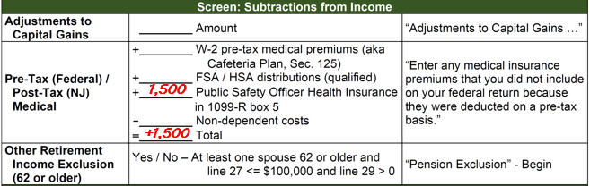
PSO Insurance Premiums Added to Medical Expenses on NJ Checklist
PSO insurance premiums
added to NJ medical
expenses

Slide 41
Using Bogart Annuity Calculator to Determine Taxable Amount of Distribution for Box 2a
Pause slide show
Listen to lesson entitled “Bogart Annuity Calculator” for instructions on how to use the calculator to determine the taxable amount of the pension
  On Core Training Exercises Checklist
After listening to that lesson, return to this slide in Step 3

Slide 42
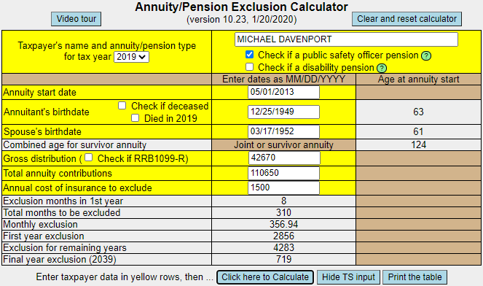
Results of Bogart Annuity Calculator for Davenport
Be sure to print results
and include in
taxpayer’s envelope

Slide 43
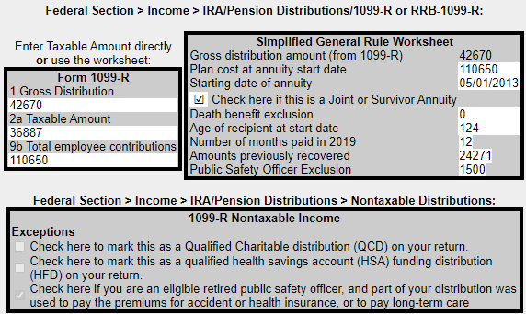
Results of Bogart Annuity Calculator for Davenport
cont’d
Can enter this info
onto Simplified
Method Work-
Sheet screen
(see slide 48)
Can enter this info directly onto 1099-R screen
(see slide 45)
Enter on Non-
Taxable Income
screen (see slide
51)

Slide 44
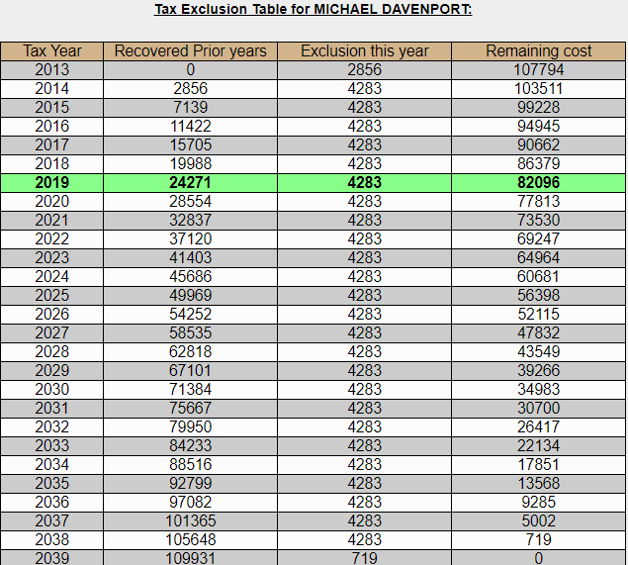
Results of Bogart Annuity Calculator for Davenport
cont’d

Slide 45
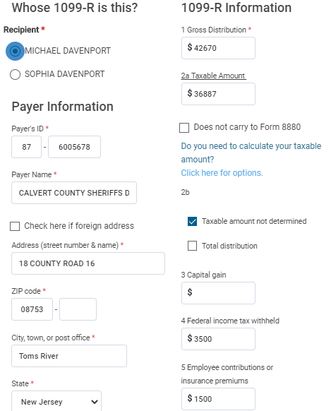
TSO - Entering 1099-R for Calvert County Sheriff’s Department
Federal Section>Income> IRA/Pension Distributions >Add or Edit a 1099-R
Gross distribution from Box 1
Taxable amount from Bogart Annuity
Calculator (left side of slide 43)
Taxable amount not determined - checked
Federal income tax withheld
PSO health insurance premiums

Slide 46
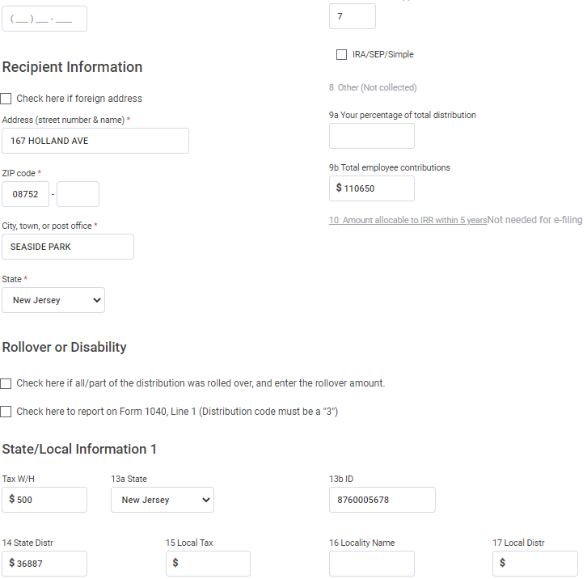
TSO - Entering 1099-R for Calvert County Sheriff’s Department
Federal Section>Income> IRA/Pension Distributions >Add or Edit a 1099-R
cont’d
Normal distribution
Total employee contributions
NJ income tax withheld
Choose NJ from drop-down menu
TSO automatically populates

Slide 47
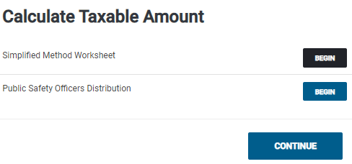
TSO – Alternate Way to Enter Info from Bogart Annuity Calculator
Federal Section>Income> IRA/Pension Distributions >Add or Edit a 1099-R>Options
On 1099-R screen under Box 2a, TSO asks: “Do you need to calculate your taxable amount?” Click on “Click here for options”
Includes PSO exclusion
Use for PSO exclusion if
taxable amount is given
on 1099-R

Slide 48
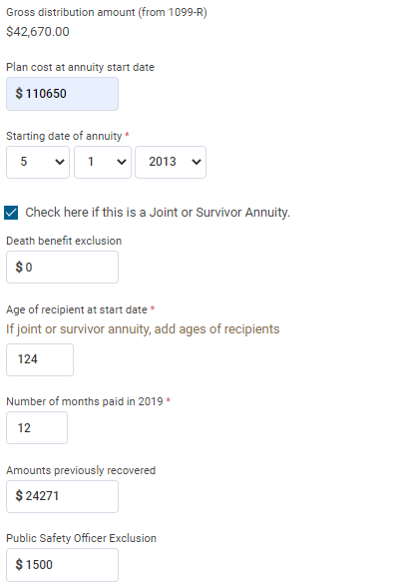
TSO – Simplified Method Worksheet Screen
Federal Section>Income> IRA/Pension Distributions >Add or Edit a 1099R>Options>Simplified Method Worksheet
Advantage to this method:
Data carries forward to
following year
Info from Bogart Annuity
Calculator
(see slide 43 – right side)

Slide 49
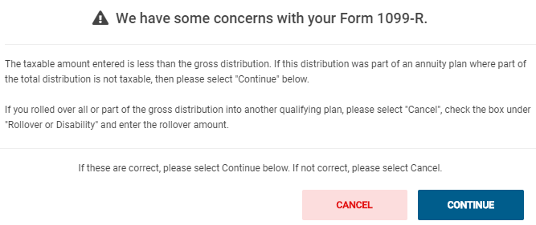
TSO – Warning about Form 1099-R
TSO displays when taxable amount is less than gross distribution. In Davenport case, just click Continue

Slide 50
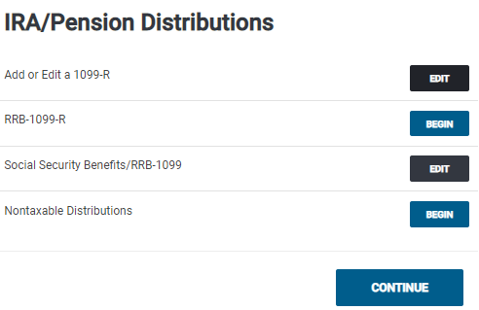
TSO – Entering Reason for Excludable Portion of 1099-R Federal Section>Income> IRA/Pension Distributions

Slide 51
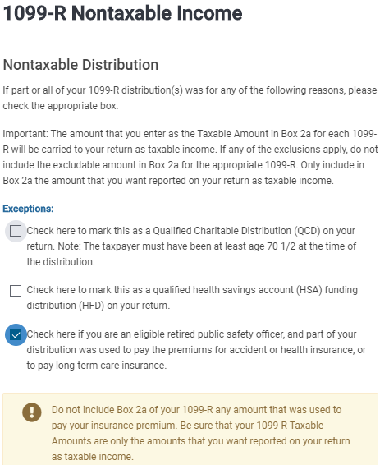
TSO – Entering Reason for Non-Taxable Portion of 1099-R
Federal Section>Income> IRA/Pension Distributions >Nontaxable Distributions
Info from Bogart Annuity
calculator (see slide 43
bottom)

Slide 52
NJ Excludable Pension Amounts on NJ Checklist
Taxable amount of pension from Box 2a flows through to NJ 1040 Line 20a
Excludable amount of pension due to after-tax pension contributions must be manually entered on NJ 1040 20b
  Use excludable amount shown on Tax Exclusion Table in Bogart Annuity Calculator results (see slide 44)
  Enter as Adjustment to Line 20b on NJ Checklist in Income Subject to Tax section
Don’t forget to also do NJ Checklist entries for the PSO health insurance premiums
  Refer to NJ Special Handling document for details on these entries

Slide 53
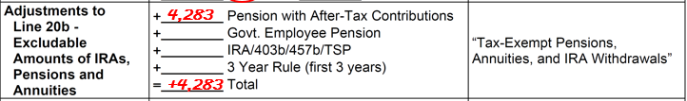
Excludable Pension Amount From Bogart Annuity Calculator on NJ Checklist
Excludable pension
amount added to Line 20b
Don’t forget to also do NJ Checklist entries for PSO health insurance premiums; refer
to NJ Special Handling document for details

Slide 54
TSO - Student Activity
Federal Section>Income> IRA/Pension Distributions >Add or Edit a 1099-R
Pause the slide show
Determine the taxable and excludable amounts of the pension by using the Bogart Annuity calculator on the TP4F Preparer page
Enter the 1099-R from Calvert County Sheriff’s Department into TSO (Step 3)
  Enter info from Bogart Annuity calculator directly onto 1099-R screen or by using Simplified Method Worksheet screen in TSO
  Don’t forget to complete the Nontaxable Distributions screen also
Check the Federal and NJ refund monitors

Slide 55
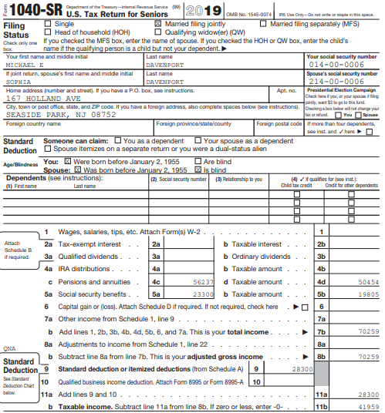
TSO – Davenport Pension Amounts on Federal 1040
Gross amount of Military
and Sheriff’s Department
pensions
($13,567 + $42,670)
Taxable amount of Military
and Sheriff’s Department
pensions
($13,567 + $36,887)

Slide 56
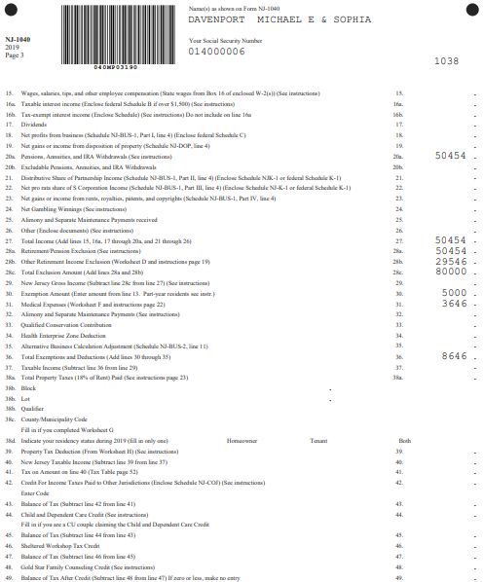
TSO – Davenport Pension Amounts on NJ 1040
Taxable amount of Military and Sheriff’s
Department pensions from Federal
($13,567 + $36,887)
Military pension will show on NJ 1040
until adjusting entry from NJ Checklist
is entered in TSO State section (Step 15d)
Tax-exempt portion of Sheriff’s Department
pension will not appear on Line 20b until
adjusting entry from NJ Checklist is entered
in TSO State section (Step 15d)
Medicare premiums that exceed 2%
of NJ Gross Income
PSO insurance premiums will not
appear on Line 31 until adjusting
entry from NJ checklist is entered
In TSO State section (Step 15e)

Slide 57
Other 1099-R Situations
Money transferred from one tax-deferred account into another (e.g. – 401k to IRA or one IRA to another IRA)
Entries on tax documents and treatment in TaxSlayer depend upon circumstances of transfer
Counselor needs to fully understand what occurred
Three common scenarios we see
  Direct IRA trustee-to-trustee transfer
  Direct transfer from a qualified retirement plan like a 401k to an IRA (Taxpayer does not receive money)
  60-day indirect rollover (Taxpayer receives money)
Notes:
57

Slide 58
Direct IRA Trustee-to-Trustee Transfer
Transfer of assets from IRA under one trustee to IRA under a different trustee without taxpayer ever taking control of money
  No limit on how many can be done in one year
Can be done electronically (receiving trustee requests from original trustee) or distribution check can be issued in name of receiving trustee (not in taxpayer’s name)
Not reported on 1099-R
Not a taxable event; nothing in TaxSlayer
Receiving trustee does not issue a Form 5498 to show how much was received
Notes:
58

Slide 59
Direct Transfer from a Qualified Retirement Plan to an IRA or Another Qualified Retirement Plan (Taxpayer Does Not Receive Money)
Transfer of assets from a qualified retirement plan (e.g. – 401k) into an IRA (or another qualified retirement plan) - Taxpayer does not receive money
Reported on 1099-R with Code G in Box 7
TaxSlayer handles automatically
Form 5498 may be issued by receiving plan with amount received in Box 2
  Do nothing with Form 5498 in TaxSlayer
Notes:
59

Slide 60
Indirect 60-Day IRA Rollover (Taxpayer Receives Money)
Assets in IRA are withdrawn via check made out to taxpayer; funds are re-deposited with another trustee
Original trustee reports distribution on 1099-R as a normal distribution (code 1 or 7) since it does not know what taxpayer will do with the money
If re-deposited in another IRA within 60 days, considered a rollover and is not taxable
Can make only one rollover from one IRA to another or one Roth IRA to another Roth IRA in any 12-month period, regardless of the number of IRAs owned
Notes:
60

Slide 61
Indirect 60-Day IRA Rollover (Taxpayer Receives Money)
cont’d
  If more than one rollover, distributions after first become taxable. May incur 10% early distribution penalty if under age 59 ½. Out of scope for us
  Limit does not apply to direct Trustee-to-Trustee transfers, conversions from traditional to Roth IRAs, or transfers between IRAs and qualified retirement plans (or vice versa)
Reported on 1099-R with Code 1 or 7 in Box 7
  Enter 1099-R into TaxSlayer as usual
  Enter taxable amount in Box 2a (amount not rolled over)
Notes:
61

Slide 62
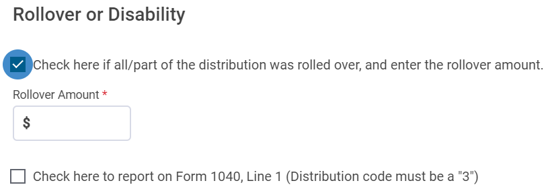
Indirect 60-Day IRA Rollover (Taxpayer Receives Money)
Federal Section>Income> IRA/Pension Distributions >Add or Edit a 1099-R
cont’d
  Check box that says, “Check here if all/part of the distribution was rolled over, and enter the rollover amount”
  Enter the amount rolled over. TaxSlayer will not include that amount on 1040 Line 4b as taxable

Slide 63
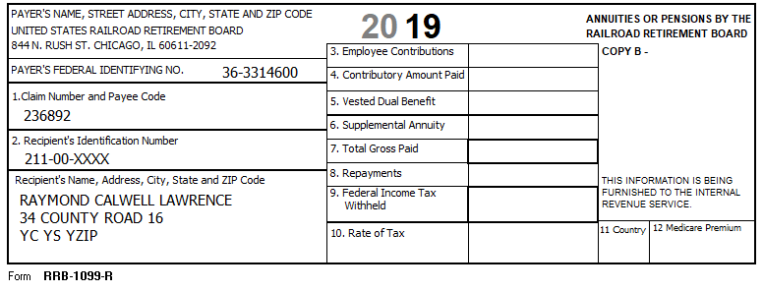
Form RRB-1099-R – Tier 2 – Pension Equivalent
Notes:
Click 1 – Total Gross Paid
Click 2 – Federal Income Tax withheld
Click 3 – Employee Contribution. Use Bogart calculator to determine taxable portion of Tier 2 benefits.
Click 4 – Medicare Premium that needs to be added to Schedule A
See Pub 4012 for directions for entering information. Distribution code is generally 7
Retirement portion is GREEN
Social Security portion is blue

Slide 64
Scenario Steps 4 and 5
1099-MISC Jerry’s Honey Jar and Schedule E

Slide 65
Rental Income
Refer to Pub 4012 Page D-50
In Scope:
  Land-only rental or gas/oil lease
    If reported on 1099-MISC, enter on TSO 1099-MISC screen and attach to Schedule E
    If cash income, enter directly on Schedule E
    Only expense can be property taxes, which is reported as an itemized deduction on Schedule A

Slide 66
Rental Income
cont’d
In Scope:
  Rental of a personal residence that taxpayer used personally for at least 15 days and rented for no more than 14 days during the year
    Generally not a taxable event, so do not enter the income or expenses
    If reported on a 1099-MISC:
      Enter income on 1099-MISC screen and attach to a Schedule E
      Enter the same amount as an Additional Expense labeled "less than 15-day rental of main home“ (This zeroes out the income)
Out of Scope:
  Rental income from room in home, apartment over garage, separate building, Airbnb, etc. (that doesn’t meet criteria above)

Slide 67
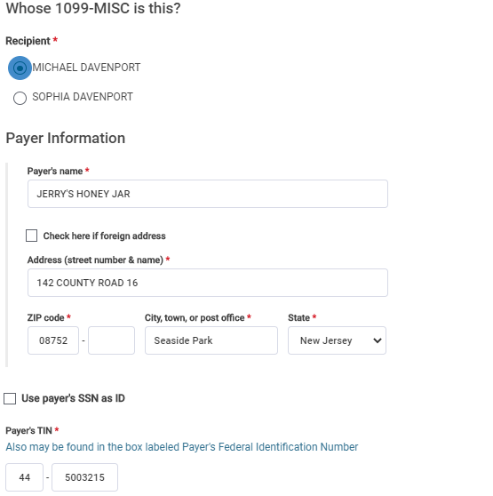
TSO – Entering 1099-MISC for Land Rental
Federal Section>Income>1099-MISC
Enter Payer’s name,
address and TIN

Slide 68
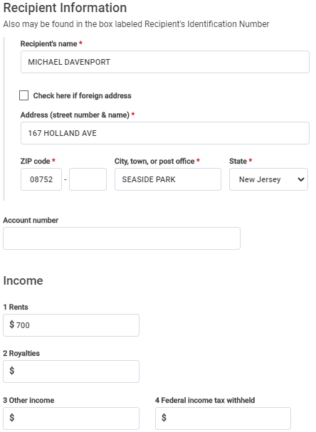
TSO – Entering 1099-MISC for Land Rental
Federal Section>Income>1099-MISC
cont’d
Rental income for land

Slide 69
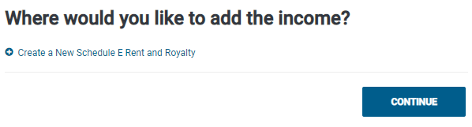
TSO – Attaching 1099-MISC to Schedule E
Federal Section>Income>1099-MISC>Create a New Schedule E Rent and Royalty

Slide 70
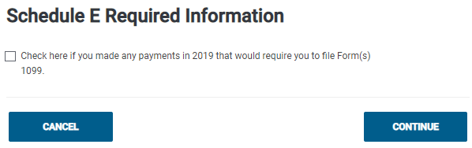
TSO – Entering Schedule E Required Information
Federal Section>Income>1099-MISC>Schedule E Required Information

Slide 71
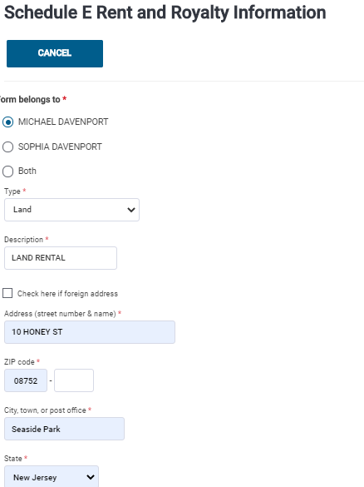
TSO – Entering Basic Information for Schedule E
Federal Section>Income>Supplemental Income and Loss
To enter basic information
about land rental
Choose Land from drop-down menu
Address of rental land

Slide 72
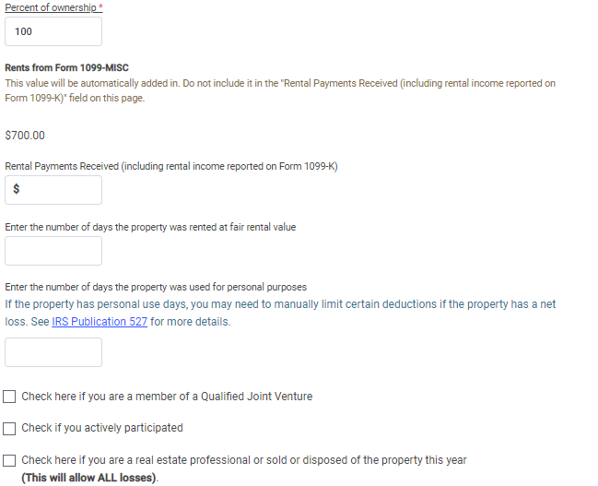
TSO – Entering Basic Information for Schedule E
Federal Section>Income>Supplemental Income and Loss
cont’d
To enter basic information
about rental land
Percent of ownership
TSO transfers from 1099-MISC
Used for cash payments received
(none for Davenport)

Slide 73
TSO - Student Activity
Federal Section>Income>1099-MISC
Pause the slide show
Enter the 1099-MISC from Jerry’s Honey Jar into TSO (Step 4)
Link the 1099-MISC to a Schedule E and hit “Continue” on Schedule E Required Information screen
Enter Basic Information about the land rental (Step 5)
Check the Federal and NJ refund monitors after each step

Slide 74
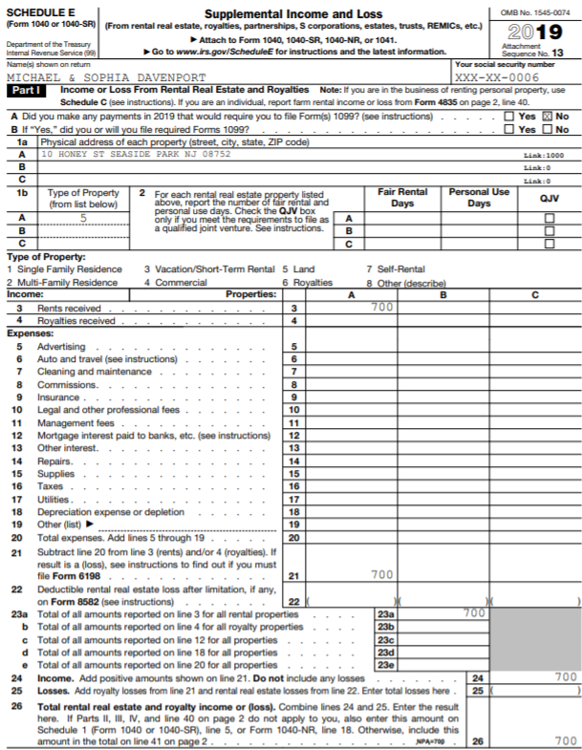
TSO – Land Rental Income on Schedule E
Address of land
Land rental income
Total rental income

Slide 75
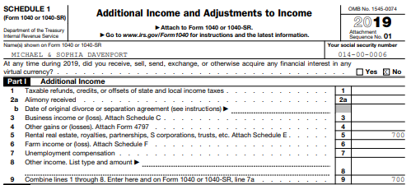
TSO – Rental Income on Schedule 1, Part I
Rental income from
Schedule E
Total Additional income

Slide 76
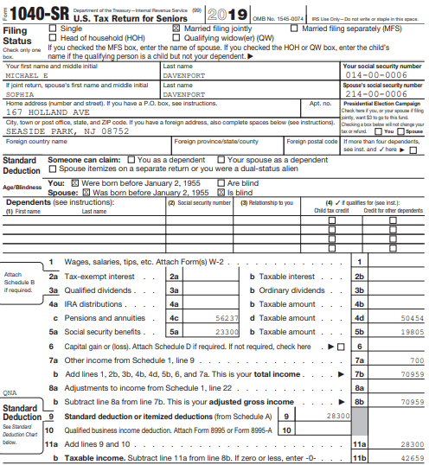
TSO – Rental Income on Federal 1040
Total Additional Income from
Schedule 1, Part I

Slide 77

TSO – Rental Income on NJ 1040
Rental income

Slide 78
Scenario Step 6
State Tax Refund, Property Tax Reimbursement (PTR) and Homestead Benefit (HB) Recoveries

Slide 79
Overview of NJ Property Tax Relief Programs
Before starting step 6, listen to lesson entitled “NJ Property Tax Relief Programs” for an overview of various NJ programs
  On Core Training Exercises Checklist
Then listen to lesson entitled “Handling NJ Income Tax and Property Tax Recoveries”
  On Core Training Exercises Checklist
After listening to both lessons, return to this step 6

Slide 80
Is Davenport NJ Income Tax Refund a Recovery?
On Intake/Interview sheet, Davenports noted a $467 state income tax refund they received in 2019 when they filed 2018 NJ return
Counselor verified refund amount using NJ Form 1099-G Inquiry (Refund) link on TP4F Preparer page
Looking at prior year return, counselor saw that Davenports itemized deductions on Schedule A and claimed state income taxes paid on Line 5a
DID DAVENPORT RECEIVE A TAX BENEFIT LAST YEAR BY CLAIMING STATE INCOME TAXES PAID?
IS NJ INCOME TAX REFUND A RECOVERY?
DOES NJ INCOME TAX REFUND NEED TO BE CLAIMED AS INCOME IN 2019?

Slide 81
Is Davenport Income Tax Refund a Recovery?
DID DAVENPORTS RECEIVE A TAX BENEFIT LAST YEAR BY CLAIMING STATE INCOME TAXES PAID? YES, THEY CLAIMED INCOME TAXES PAID ON SCHEDULE A LINE 5
IS NJ INCOME TAX REFUND A RECOVERY? YES
DOES IT NEED TO BE CLAIMED AS INCOME IN 2019? YES, SOME OR ALL OF REFUND MAY BE TAXABLE ON CURRENT YEAR RETURN

Slide 82
Are Davenport PTR and HB Recoveries?
Looking at prior year return, counselor saw that Davenports itemized deductions on Schedule A and claimed property taxes on Line 5b
DID DAVENPORTS RECEIVE A TAX BENEFIT LAST YEAR BY CLAIMING PROPERTY TAXES?
IS NJ PTR A RECOVERY?
After discussion with Davenports, counselor determined that they also itemized deductions 3 years ago and claimed property taxes
IS NJ HB A RECOVERY?
DO PTR AND HB NEED TO BE CLAIMED AS INCOME IN 2019?

Slide 83
Are Davenport PTR and HB Recoveries?
DID DAVENPORTS RECEIVE A TAX BENEFIT LAST YEAR AND 3 YEARS AGO BY CLAIMING PROPERTY TAXES? YES, THEY HAVE BEEN CLAIMING PROPERTY TAXES ON SCHEDULE A LINE 5b FOR THE PAST 3 YEARS
IS NJ PTR A RECOVERY? YES
IS NJ HB A RECOVERY? YES
DO PTR AND HB NEED TO BE CLAIMED AS INCOME IN 2019? YES, SOME OR ALL OF REFUNDS MAY BE TAXABLE ON CURRENT YEAR RETURN

Slide 84
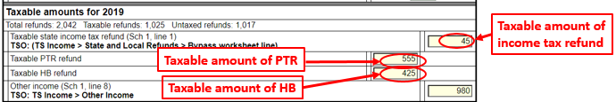
How Much of NJ Income Tax Refund, PTR, and HB Are Taxable in Current Tax Year?
Use NJ Tax Refund Worksheet and NJ Sales Tax Worksheet to determine how much of NJ income tax refund, PTR, and HB are taxable in current year

Slide 85
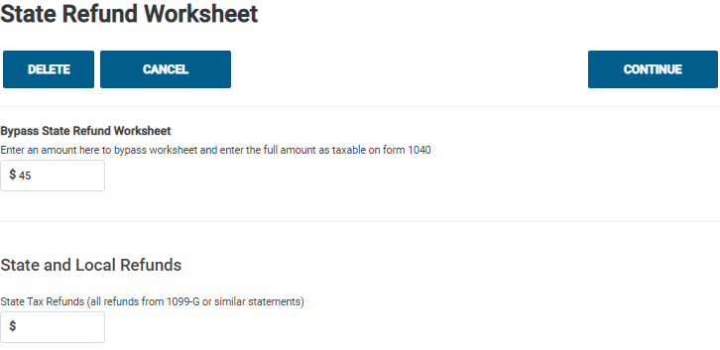
TSO – Entering Taxable Amount of State Income Tax Refund
Federal Section>Income>Form 1099-G Box 2
Bypass TSO State Refund Worksheet since we
used tool on TP4F
Taxable amount of
income tax refund from
NJ Tax Refund Worksheet

Slide 86
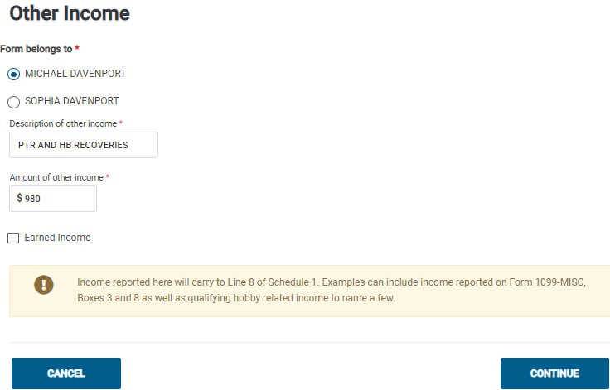
TSO – Entering Taxable Amount of PTR and HB
Federal Section>Income>Less Common Income>Other Income Not Reported Elsewhere
Taxable amount of PTR and HB
from NJ Tax Refund Worksheet

Slide 87
Recoveries on NJ Checklist
NJ does not tax any of the recovery amounts
State income tax recovery does not flow through to NJ 1040
  No need for NJ Checklist entry
PTR and HB recoveries on Federal Other Income line do flow through to NJ 1040 Other Income line (Line 26)
  Need to enter PTR and HB recoveries as negative amounts as Adjustment to Line 26 in Income Subject to Tax section of NJ Checklist

Slide 88
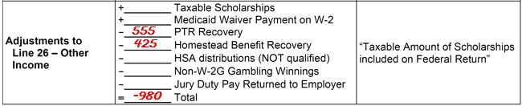
PTR and HB Recoveries on NJ Checklist

Slide 89
TSO - Student Activity
Federal Section>Income>Form 1099-G Box 2
Federal Section>Income>Less Common Income>Other Income Not Reported Elsewhere
Pause the slide show
Enter the taxable recoveries into TSO (Step 6)
  Complete NJ Tax Refund Worksheet on TP4F Preparer page
    To calculate required amount of prior year’s sales tax, complete NJ Sales Tax Worksheet also on TP4F Preparer page
  Enter taxable amount of NJ income tax refund into TSO on State Tax Refund screen
  Enter taxable amount of PTR and HB into TSO on Other Income screen
Check the Federal and NJ refund monitors

Slide 90
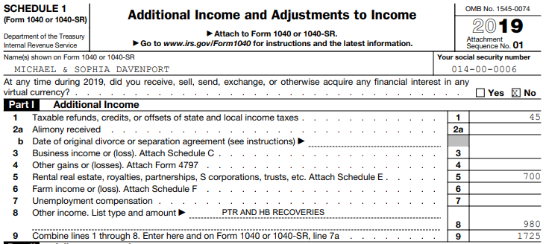
TSO – Recoveries on Schedule 1, Part I
Taxable NJ income tax refund
Taxable PTR and HB
Total of all Additional
Income from Part 1

Slide 91
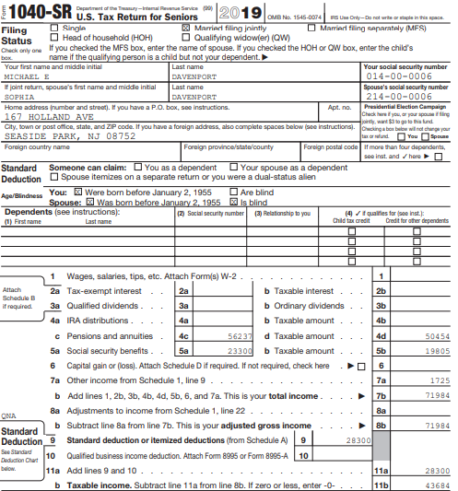
TSO – Recoveries on Federal 1040
Total of Additional Income
from Schedule 1, Part I

Slide 92
Scenario Step 7
1099-B Lincoln Investment Services

Slide 93
Capital Assets
What is a capital gain (loss)?
  It’s your profit (loss) when you sell a capital asset for more (less) than you invested in it
Capital assets
  Generally, nonbusiness assets such as securities (e.g. - stocks, bonds, mutual funds)
NOT a capital asset
  Inventory
  Property used as a rental or in a business

Slide 94
Capital Assets
cont’d
  Copyright
  Literary, musical, or artistic composition letter, memo or similar
“Sort-of” capital assets
  Homes and other personal use items (e.g. boat, jewelry, car, etc.)
    Considered capital assets for gains (taxed)
    Considered personal assets for losses (not deductible)

Slide 95
Elements of a Capital Asset Sale
Key elements:
  When was it acquired?
  When was it sold?
  How much was received upon sale?
  How much was the cost basis?
Info obtained from end-of-year tax statement and taxpayer
  1099 B - Proceeds From Broker & Barter Exchange Transactions
  Consolidated Brokerage Statement
Notes:
95

Slide 96
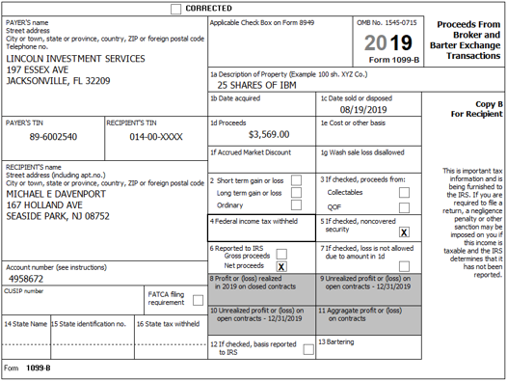
Sample 1099-B
Date sold
Sale proceeds
Non-covered security;
Cost does not have to be reported
by issuer
Net proceeds

Slide 97
Acquisition Date
Date acquired
  Can be a specific date
  If same asset was purchased on multiple dates (e.g. -different lots of same stock), can use Various as date acquired
  Can be the date that asset was inherited
    Date of death of decedent – this is Davenport situation

Slide 98
Sales Proceeds
Can be reported as gross proceeds or net proceeds (less commissions)
  Must indicate on tax form whether gross or net is being reported to IRS
    If net proceeds, use as is
    If gross proceeds are reported, can reduce profit or add to loss to reflect commissions paid by entering an adjustment into TSO

Slide 99
Cost Basis
Cost basis is cost plus commission paid on purchase
  If multiple lots, use cost basis of First In First Out (FIFO) shares purchased unless specified in writing before sale
Original basis is adjusted by any stock split or nondividend distributions (return of principal)
Tax law allows use of average of stock price during approximate period of purchase, if no other records are available
  Must be provided by taxpayer
Cost basis for an inherited asset is Fair Market Value (FMV) on date of death of decedent

Slide 100
Cost Basis
cont’d
Adjusted cost basis and short/long-term status for “covered securities” must be reported on 1099-B
Securities are “covered” if they were acquired after:
  1/1/2011 Stocks (including REITs, ADRs, & some ETFs)
  1/1/2012 Mutual funds, stock DRIPS, rest of ETFs
  1/1/2013 Notes, bonds, options, commodities
If securities were purchased prior to required coverage date, taxpayer must provide cost basis

Slide 101
Out-of-Scope Situations
Capital asset inherited in 2010, unless cost is provided by executor of will
  Tax law changed for that one year
Capital asset received as a gift, unless cost and holding period is provided by taxpayer
Taxpayer cannot provide cost basis
  In scope if taxpayer agrees to take zero as cost basis
Employee stock options (ESOP)
Average of stock price, if counselor must calculate
  In scope if taxpayer provides calculation

Slide 102
Short- vs. Long-Term
Stock held one year or less is short term
  Begin counting the day after the trade date and include the day of sale
  Taxed at regular tax rates
Stock held more than one year is long term
  Taxed at lower capital gains rates
  Inherited stock always considered long term, no matter how long held
If “Various” is chosen for acquired date, split between “Various – short term” vs. “Various - long term” transactions

Slide 103
Wash Sales
Definition of a wash sale:
  A stock/fund sold by taxpayer at a loss and substantially equivalent stock/fund is purchased within 30 days (either before or after sales date)
  The loss is not deductible
1099-B, brokerage statement will show:
  Original sales price in Box 1d & cost in Box 1e
  Wash Sales Disallowed
Enter as an adjustment to a capital gain/loss
  Choose “Nondeductible Loss from a Wash Sale” as the adjustment explanation
  Enter as a positive number to increase profit/reduce loss
Add disallowed loss to cost basis of new stock bought
Notes:
103

Slide 104
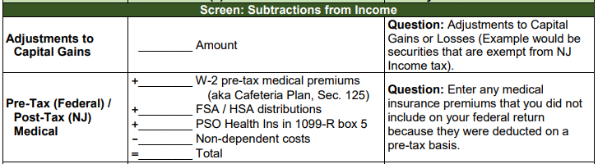
Non-Taxable NJ Securities
Gains on certain NJ Securities are exempt from NJ tax even though subject to Federal capital gains tax
  See NJ Bulletin GIT-5 for a list of these securities (link from TaxPrep4Free.org Preparer page)
The NJ return has to be adjusted when this situation occurs
Capture exempt capital gains amount in NJ Checklist Subtractions from Income section

Slide 105
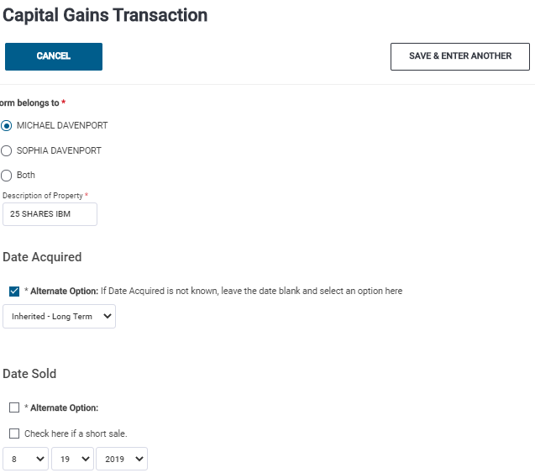
TSO – Entering 1099-B for Capital Gains
Federal Section>Income>Capital Gains and Losses>Capital Gain and Loss Items
Click on Alternate Options; choose
Inherited from drop-down menu;
always long term
Date sold

Slide 106
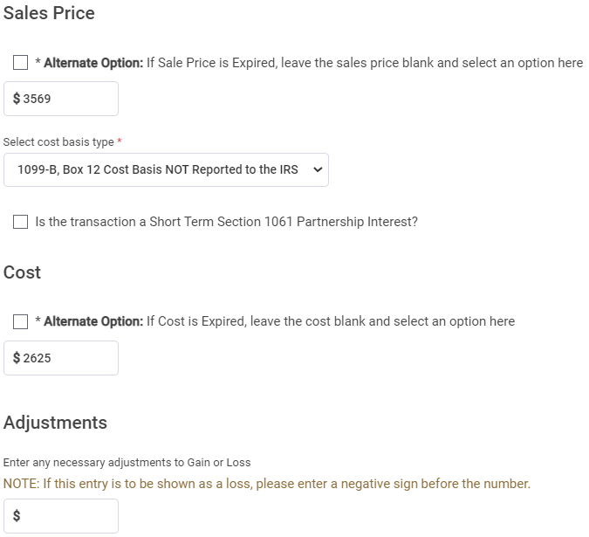
TSO – Entering 1099-B for Capital Gains
Federal Section>Income>Capital Gains and Losses>Capital Gain and Loss Items
cont’d
Sales proceeds
Box 12 not checked
FMV on date of death
No adjustments needed
for Davenport 1099-B

Slide 107

TSO – Entering 1099-B for Capital Gains
Federal Section>Income>Capital Gains and Losses>Capital Gain and Loss Items
cont’d
Refer to Pub 4012 Page D-26
Possible adjustment explanations;
none needed for Davenport
Adjustment explanation
used for wash sale

Slide 108
TSO - Student Activity
Federal Section>Income>Capital Gains and Losses>Capital Gain and Loss Items
Pause the slide show
Enter the 1099-B from Lincoln Investment Services into TSO (Step 7)
Check the Federal and NJ refund monitors

Slide 109
Form 8949
After transactions are entered in Capital Gain/Loss section, TSO will transfer transactions to Form 8949
Up to six separate 8949 pages may be populated:
  Code A - S/T with cost reported to IRS
  Code B - S/T with cost not reported to IRS
  Code C - S/T not reported on 1099-B
  Code D - L/T with cost reported to IRS
  Code E - L/T with cost not reported to IRS – Lincoln Investment Services
  Code F - L/T not reported on 1099-B
Notes:
109

Slide 110

TSO – Long-Term Transactions on Form 8949 – Cost Basis Not Reported to IRS
Long-term transactions
where cost basis is not
reported to IRS

Slide 111
Capital Gains & Losses on Schedule D
TaxSlayer transfers data from 8949s to Schedule D
Schedule D shows summary lines of transferred totals
  Line 1b – S/T with Box A checked in Part I on 8949
  Line 2 – S/T with Box B checked in Part I on 8949
  Line 3 – S/T with Box C checked in Part I on 8949
  Line 8b – L/T with Box D checked in Part II on 8949
  Line 9 – L/T with Box E checked in Part II on 8949 – Lincoln Investment Services
  Line 10 – L/T with Box F checked in Part II on 8949
Notes:
111

Slide 112

TSO – Capital Gains on Schedule D
Totals from 8949 Code E

Slide 113

TSO – Capital Gains on Federal 1040
Capital gain total from
Schedule D

Slide 114

TSO – Capital Gains on NJ 1040
Capital gains

Slide 115
Scenario Step 8
Capital Loss Carryover

Slide 116
Net Capital Loss
Capital losses can be used to offset gains
If result after netting gains and losses is a net loss, up to $3,000 can be used to reduce other taxable income in the current tax year ($1,500 if MFS)
The loss amount in excess of $3,000 ($1,500 if MFS) is then carried forward to the next tax year
TSO creates a Capital Loss Carryover Worksheet to track remaining capital loss for next year’s return
  Short- or long-term classification is maintained
  No limit to how many times a loss can be carried forward
Notes:
116

Slide 117

TSO – Maximum Capital Loss on Federal 1040
Maximum capital loss

Slide 118

TSO – Capital Loss Carryover Worksheet
Excess capital loss over
-$3,000 to carry forward
to next year’s return
Long-term classifica-
tion is maintained

Slide 119
Net Capital Loss on NJ Return
NJ only allows taxpayer to use capital losses to offset capital gains in the same year. No net capital loss is permitted
  TSO will not populate anything on NJ 1040 Line 18 Net Profits from Business if net capital loss
NJ also does not permit capital loss carryover to next year’s return
Notes:
119

Slide 120

Capital Loss on NJ 1040
NJ does not allow a net capital loss

Slide 121
Capital Loss Carryover from Prior Year’s Return
Always check prior year’s tax return to determine if there was a capital loss carryover
  Federal 1040 will show -$3,000 on Capital Gain or Loss line
  Capital Loss Carryover Worksheet will show amount of carryover loss and short- or long-term classification
Carryover losses are combined with the gains and losses that actually occur in the current year to determine net capital gain/loss for current year
Up to $3,000 ($1,500 if MFS) loss offsets other income on current year return. Rest of loss is carried forward to next year
No limit to how many times a loss can be carried forward
Notes:
121

Slide 122
Davenport’s Capital Loss Carryover from Prior Year’s Return
Line 8 of Life Events section of Davenport’s Intake/Interview sheet shows they had a capital loss carryover
Review of prior year return shows a short-term loss of $1,309 was carried over
  Shown on page 1 of scenario
Must be entered under Schedule D Capital Gains menu in TSO
  TSO will automatically populate if taxpayer consented to carryforward data on last year’s return
Notes:
122

Slide 123

TSO – Schedule D Capital Gains Menu
Federal Section>Income>Capital Gains and Losses

Slide 124

TSO – Entering Capital Loss Carryover from Prior Year
Federal Section>Income>Capital Gains and Losses>Other Capital Gains Data
Short-term carryover loss
for Michael
Enter as a positive number,
even though loss

Slide 125
TSO - Student Activity
Federal Section>Income>Capital Gains and Losses>Other Capital Gains Data
Pause the slide show
Enter the Davenports’ Capital Loss Carryover into TSO (Step 8)
Check the Federal and NJ refund monitors

Slide 126

TSO – Short-Term Capital Loss Carryover on Schedule D, Part I
Short-term capital loss carryover from
prior year’s return
Net short-term loss
Net long-term gain

Slide 127

TSO – Net Capital Loss on Schedule D, Part III
Net capital loss
Short-term loss -$1,309
minus
long-term gain +944
= -$365

Slide 128

TSO – Capital Loss on Federal 1040
Capital loss total from
Schedule D, Part III

Slide 129
TSO – Capital Loss on NJ 1040
NJ does not allow a net capital
loss

Slide 130
Scenario Step 9
Sonic Brokerage Statement

Slide 131
Components of Consolidated Brokerage Statement
A consolidated brokerage statement usually contains multiple 1099 statements
  1099-DIV
  1099-INT
  1099-MISC Enter on corresponding TSO screens
  1099-OID
  1099-B
Can also contain:
  End-of-year back-up details behind the 1099 statements
  Summary of Supplemental Information not reported to IRS

Slide 132
Scenario Step 9a
Sonic Brokerage Statement – 1099-DIV

Slide 133

Davenport 1099-DIV from Brokerage Statement
Enter as normal on 1099-DIV screen
  Total ordinary dividends (Box 1a)
  Qualified dividends (Box 1b)
  Total capital gains distributions (Box 2a)

Slide 134

TSO – Entering 1099-DIV from Brokerage Statement
Federal Section>Income>1099-DIV, INT, OID>Interest or Dividend Income>Dividend Income, Form 1099-DIV
Use payer’s name on brokerage statement,
not brokerage name
For both Michael and Sophia
Ordinary dividends
Qualified dividends
Capital gains distributions

Slide 135
TSO - Student Activity
Federal Section>Income>1099-DIV, INT, OID>Interest or Dividend Income> Dividend Income, Form 1099-DIV
Pause the slide show
Enter the 1099-DIV from the Sonic Brokerage Statement into TSO (Step 9a)
Check the Federal and NJ refund monitors

Slide 136

TSO – 1099-DIV Dividends on Schedule B, Part II
1099-DIV dividends

Slide 137

TSO – Capital Gains Distributions on Schedule D
Capital gains distributions –
always long term

Slide 138

TSO – Dividends and Capital Gains Distributions on Federal 1040
Qualified dividends
168
Ordinary dividends
Includes capital gains
distributions

Slide 139

TSO – Dividends and Capital Gains Distributions on NJ 1040
Ordinary dividends; qualified dividends do not flow through to NJ
Includes capital gains
distributions;
NJ does not allow capital
loss carryover from prior
year, so NJ capital gains are
higher than Federal

Slide 140
Scenario Step 9b
Sonic Brokerage Statement – 1099-INT

Slide 141

Davenport 1099-INT from Brokerage Statement
Enter as normal on 1099-INT screen
  Interest income (Box 1)
    Taxable for both Federal and NJ

Slide 142

TSO – Entering 1099-INT
Federal Section>Income>1099-DIV,INT,OID>Interest or Dividend Income>Interest Income, Form 1099-INT
Use payer’s name on brokerage statement
For both Michael and Sophia
Taxable interest

Slide 143
TSO - Student Activity
Federal Section>Income>1099-DIV,INT,OID>Interest or Dividend Income>Interest Income, Form 1099-INT
Pause the slide show
Enter the 1099-INT from the Sonic Brokerage Statement into TSO (Step 9b)
Check the Federal and NJ refund monitors

Slide 144

TSO – Interest on Schedule B
Taxable interest
from Box 1

Slide 145

TSO – Interest on Federal 1040
Taxable interest

Slide 146

TSO – Interest on NJ 1040
Taxable interest

Slide 147
Scenario Step 9c
Sonic Brokerage Statement – 1099-B

Slide 148
Consolidating Capital Gains Transactions on Capital Gains/Loss Screen
Refer to Pub 4012 Page D-25
When 1099-B has numerous capital gains transactions, you do not have to enter each one separately
  Divide the transactions into 4 categories:
    Short-term transactions with basis reported to the IRS (Box A checked on 8949)
    Short-term transactions with basis not reported to the IRS (Box B checked on 8949)
    Long-term transactions with basis reported to the IRS (Box D checked on 8949)
    Long-term transactions with basis not reported to the IRS (Box E checked on 8949)

Slide 149
Consolidating Capital Gains Transactions on Capital Gains/Loss Screen
cont’d
  Enter the total of each category on a separate TSO capital gain entry screen
  Choose adjustment reason that states, “Reporting multiple transactions on a single row” from list (adjustment code M); enter 0 as adjustment amount
    If any of the transactions in that category also require another adjustment, just select another reason from the check boxes; okay to choose multiple adjustment explanations
    Add adjustment amounts together and enter total
  For transactions where the cost basis is not reported to the IRS (Box B/Box E checked), inform the taxpayer that the IRS may request copies of the brokerage statement as proof
    Do not attach any documents to e-file or mail any documents to IRS

Slide 150
Supplemental Information Contained in Consolidated Brokerage Statement
Shown on Pages 12 and 13 of Scenario
Details of 1099-DIV transactions
Details of capital gains distributions
Details of 1099-INT transactions
None of the details are reported to the IRS

Slide 151

TSO - Entering 1099-B from Brokerage Statement –
Short-Term Transactions, Basis Is Reported to IRS
Federal Section>Income>Capital Gains and Losses>Capital Gain and Loss Items
Use payer’s name as Description
Choose Alternate Option and
Various – Short Term for Date Acquired
If Various is chosen for date acquired,
do not enter Date Sold; choose Alternate
Option; do not choose anything from
drop-down menu
Use Proceeds from total line as Sales Price

Slide 152

TSO – Entering 1099-B from Brokerage Statement –
Short-Term Transactions, Basis Is Reported to IRS
Federal Section>Income>Capital Gains and Losses>Capital Gain and Loss Items
cont’d
Choose Cost Basis Is Reported to IRS
Use Cost Basis from total line as Cost
No adjustment amount
Choose adjustment explanation M –
Reporting Multiple Transactions on a
Single Row

Slide 153

TSO - Entering 1099-B from Brokerage Statement –
Long-Term Transactions, Basis Is Reported to IRS
Federal Section>Income>Capital Gains and Losses>Capital Gain and Loss Items
Use payer’s name as Description
Choose Alternate Option and
Various – Long Term for Date Acquired
If Various is chosen for date acquired,
do not enter Date Sold; choose Alternate
Option; do not choose anything from
drop-down menu
Use Proceeds from total line as Sales Price

Slide 154

TSO – Entering 1099-B from Brokerage Statement -
Long-Term Transactions, Basis Is Reported to IRS
Federal Section>Income>Capital Gains and Losses>Capital Gain and Loss Items
cont’d
Choose Cost Basis Reported to IRS
Use Cost Basis from total line as Cost
No adjustment amount
Choose adjustment explanation M –
Reporting Multiple Transactions on a
Single Row

Slide 155
TSO - Student Activity
Federal Section>Income>Capital Gains and Losses>Capital Gain and Loss Items
Pause the slide show
Enter the 1099-B into TSO (Step 9c)
Check the Federal and NJ refund monitors

Slide 156

TSO – Short-Term Transactions on Form 8949 – Cost Basis Is Reported to IRS (Code A)
Short-term transactions
where cost basis is
reported to IRS

Slide 157

TSO – Long-Term Transactions on Form 8949 – Cost Basis Is Reported to IRS (Code D)
Long-term transactions
where cost basis is
reported to IRS

Slide 158

TSO – Long-Term Transactions on Form 8949 – Cost Basis Is Not Reported to IRS (Code E)
Long-term transactions
where cost basis is not
reported to IRS

Slide 159

TSO – Short-Term Capital Gains and Losses on Schedule D, Part I
Totals from 8949 Code A
Short-term capital loss carryover from
prior year’s return
Net short-term loss

Slide 160

TSO – Long-Term Capital Gains and Losses on Schedule D, Part II
Totals from 8949 Code D
Totals from 8949 Code E
Capital gains distributions
Net long-term gain

Slide 161

TSO – Net Capital Loss on Schedule D, Part III
Net capital loss
Short-term loss -$12,591
minus
long-term gain +7,011
= $-5,580
Maximum loss to carry to Federal 1040

Slide 162

TSO – Capital Loss Carryover Worksheet for Next Year’s Return
Short-term capital loss carryover
for next year’s return

Slide 163

TSO – Capital Loss on Federal 1040
Maximum capital loss for current year from
Schedule D, Part III

Slide 164

TSO – Capital Loss on NJ 1040
NJ does not allow a net capital
loss

Slide 165
Scenario Step 10
K-1 ACME Holdings

Slide 166
Schedule K-1 Topics In Scope
Refer to Pub 4012 Page D-45 to D-48
Schedule K-1 issued for an investment in a partnership
  Reports each partner’s share of partnership’s earnings, losses, deductions and credits
  Usually from a passive entity and taxpayer’s investment will be at risk (must enter these in TSO)
Income reported on a K-1 that is in scope:
  Interest (including taxable and tax-exempt interest)
  Dividends (ordinary and qualified)
  Capital gains and losses (short- and long-term)
  Royalties
If K-1 contains any deductions, credits, expenses or other items not listed above, return is out of scope

Slide 167

Davenport’s Schedule K-1
Needed to
enter on
correct TSO
screen
Typically, K-1 has multiple pages; tax-exempt interest is usually reported on a later page, so don’t forget to look
Dividends
L/T capital gains

Slide 168

TSO – Schedule K-1 Sub-Menu
Federal Section>Income>Less Common Income>K-1 Earnings
Be sure to use the correct Schedule K-1 form for data entry

Slide 169

TSO – Schedule K-1 Form 1065 Sub-Menu
Federal Section>Income>Less Common Income>K-1 Earnings>Schedule K-1 Form 1065

Slide 170


TSO – Entering Schedule K-1
Federal Section>Income>Less Common Income>K-1 Earnings>Schedule K-1 Form 1065>Entity Information
Check:
From a passive entity
All investment at risk

Slide 171

TSO – Entering Schedule K-1
Federal Section>Income>Less Common Income>K-1 Earnings>Schedule K-1 Form 1065>Income
cont’d
Choose Schedule D
from drop-down menu
Long-term capital gain
Ordinary dividends
Qualified dividends

Slide 172
TSO - Student Activity
Federal Section>Income>Less Common Income>K-1 Earnings>Schedule K-1 Form 1065
Pause the slide show
Enter the Schedule K-1 into TSO (Step 10)
Check the Federal and NJ refund monitors

Slide 173

TSO – Schedule K-1 Dividends on Schedule B, Part II
Schedule K-1 dividends

Slide 174


TSO – Schedule K-1 Capital Gains on Schedule D, Part II
Schedule K-1
long-term capital gains

Slide 175

TSO – Net Capital Loss on Schedule D, Part III
Net capital loss
Short-term loss -$12,591
minus
long-term gain +8,056
= $-4,535
Maximum loss to carry to Federal 1040

Slide 176

TSO – Schedule K-1 Dividends and Capital Gains on Federal 1040
Qualified dividends
Ordinary dividends
Maximum capital loss for current year from
Schedule D, Part III

Slide 177

TSO – Capital Loss Carryover Worksheet for Next Year’s Return
Short-term capital loss carryover
for next year’s return

Slide 178

TSO – Schedule K-1 Dividends and Capital Gains on NJ 1040
Ordinary dividends;
Qualified dividends do not
flow through to NJ return
NJ does not allow a net capital
loss

Slide 179
Scenario Step 11
State Estimated Payments

Slide 180
NJ Estimated Taxes Paid
On the Intake/Interview sheet Part V Line 7, Davenport indicated that they made estimated tax payments
During the interview, Davenport said he made these 2 NJ estimated tax payments:
  4/17 $50
  6/15 $50

Slide 181

TSO – Entering State Estimated Tax Payments
Federal Section>Payments and Estimates>State Estimated Payments
NJ estimated tax
payment on 4/17
NJ estimated tax
payment on 6/15
Be sure to put last payment, if any, on correct
line to show if paid before or after 12/31 of tax year;
Needed to correctly calculate Schedule A amount for
taxes paid during tax year

Slide 182
TSO - Student Activity
Federal Section>Payments and Estimates>State Estimated Payments
Pause the slide show
Enter the 2 NJ estimated tax payments that the Davenports made into TSO (Step 11)
Check the Federal and NJ refund monitors

Slide 183

TSO – State Estimated Tax Payments on NJ 1040
2 estimated tax payments
of $50 each

Slide 184
Scenario Step 12
IRS Identity Protection Pin Entry

Slide 185
Identity Theft
Davenports indicated that Michael was a victim of identity theft on the Intake/Interview Sheet Part I Line 11
We are concerned only with tax-related identity theft
  Taxpayer has been identified as a victim by the IRS
  The tax return rejects because someone has filed a return with the taxpayer’s name and SS #
  Not concerned with credit card or identity theft if not tax related

Slide 186
Identity Theft - IRS Notices
IRS sends notices to taxpayers identified as victims (or potential victims)
CPO1 – Does NOT provide Identity Protection PIN (IP PIN)
CPO1A – Provides an IP PIN
  Taxpayer may or may not bring actual notice to the site, but must provide IP PIN to e-file
  IP PINs are issued for the taxpayer, spouse, and dependent victims of identity theft, as appropriate

Slide 187
Identity Theft – CPO1 Notice
CPO1
  “We verified your claim of identity theft and placed an identity theft indicator on your account to monitor activity and help prevent future fraud”
  “No further action is needed on your part. Please continue to file all federal tax returns”

Slide 188
Identity Theft – CPO1A Notice
CPO1A
  “Keep this letter in a safe place. You’ll need it to prepare your tax return.”
  Taxpayer will receive new IP PIN each year as long as indicator remains on account (usually 3 years)
  Assigned IP PIN is 6 digits
  “If you don’t have to file a tax return, you won’t need to use your IP PIN. We still protect your account from fraudulent filing”

Slide 189
Identity Theft - Hotline
ID Theft Toll-free Hotline 800-908-4490
  If taxpayer received IP PIN but lost it
  For ID Theft victims who have previously been in contact with the IRS and have not achieved a resolution
  The IRS will not provide the IP PIN over the phone
  If taxpayer is unable to obtain their IP PIN, IRS guidance is to file a paper return

Slide 190

TSO – Entering IP PIN
Federal Section>Miscellaneous Forms>IRS Identification PIN
6-digit IP PIN issued by IRS for Michael

Slide 191
TSO - Student Activity
Federal Section>Miscellaneous Forms>IRS Identification PIN
Pause the slide show
Enter Michael’s IP PIN into TSO (Step 12)
Federal and NJ refund monitors should not have changed from prior step

Slide 192

TSO – IP PIN on Federal 1040, Page 2
Michael’s IP PIN

Slide 193
Deductions
Michael Davenport

Slide 194

Standard Deduction – Pub 4012 Page F-2
X
X
X
3
Standard deduction for MFJ
Both over 65, Sophia blind
194

Slide 195
Scenario Step 13
Itemized Deductions

Slide 196
Itemized Deductions for Davenport
Due to substantial out-of-pocket expenses, itemized deductions for the Davenports may be higher than standard deductions, so all itemized deductions should be entered into TSO
The Davenports can claim these itemized deductions:
  Medical and dental expenses
    Refer to Pub 4012 Page F-5 to determine that all listed expenses are deductible
  Mortgage interest and expenses
    Refer to Pub 4012 Page F-9 to determine that Davenports can claim home mortgage interest

Slide 197
Itemized Deductions for Davenport
cont’d
  State taxes paid
    State income taxes or state sales tax
    Real estate taxes
  Gifts to charity
    Refer to Pub 4012 Page F-10 to determine that donations to Chamber of Commerce and Republican National Party are not deductible
The Davenports Miscellaneous deductions are no longer deductible on Schedule A
  Safe deposit box
  Investment fees
  Tax return preparation

Slide 198
Scenario Step 13a
Medical and Dental Expenses

Slide 199
Medical and Dental Expenses – Schedule A Lines 1-4
Entering expenses on specific lines is not crucial
  E.g. – Ambulance expense could go on hospital line or other medical expense line
If multiple items go on one line, can use TSO scratch pads to document individual items and calculate a total
Enter medical miles and TSO will calculate expense that can be claimed
  Mileage rate is 20 cents per medical mile

Slide 200
Medical and Dental Expenses
cont’d
TSO automatically includes the following entries you have made elsewhere on the return in the medical expense total, but it does not display them on the Medical and Dental Expenses screen
  Medicare premiums paid on your SSA-1099 (Social Security) and RRB-1099
  Self-employed health insurance you entered on Schedule C
Do not include medical/dental premiums deducted from your pay through a cafeteria plan (pre-tax)

Slide 201

TSO – Entering Medical Expenses on Schedule A
Federal Section>Deductions>Itemized Deductions>Medical and Dental Expenses
Medical expenses

Slide 202

TSO – Scratch Pads for Medical and Dental Expenses

Slide 203
TSO - Student Activity
Pause the slide show
Enter the Davenport’s medical and dental expenses into TSO (Step 13a)
Check the Federal and NJ refund monitors and Schedule A amounts

Slide 204
Scenario Step 13b
Taxes Paid

Slide 205
State Taxes Paid – Lines 5-7
State income taxes OR sales tax (whichever is greater) – Line 5a
  State income taxes include NJ income, estimated, unemployment, disability, and family leave taxes
    TSO gathers automatically from W-2s, 1099s, estimated payments, etc.
  State sales tax
    From IRS tables – based on AGI + nontaxable income
    Can add actual sales tax paid on purchases of large items, such as cars, planes, boats, and homes/additions to home
Real estate taxes (property taxes) – Line 5b
Personal property tax – Line 5c
  No personal property tax in NJ
Notes:
205

Slide 206
Non-Deductible Taxes
Federal income & excise taxes
Social Security or Medicare taxes
Federal unemployment taxes
Railroad retirement taxes
Customs duties
Federal estate & gift taxes
License fees for personal purposes, such as marriage, driver’s, and dog license fees
Certain real estate-related items, such as fees for trash collection, water, sewer, homeowners’ association charges, transfer taxes, rent surcharges due to increased real estate taxes, utilities, assessments for improvements that increase property value
Notes:
206

Slide 207
Cap on State Taxes Paid on Schedule A
Total deduction for State Taxes Paid section is limited to $10,000
  Includes state income taxes/state sales tax
  Includes property taxes
TSO handles the cap automatically

Slide 208

TSO – Entering Sales Taxes You Paid on Schedule A
Federal Section>Deductions>Itemized Deductions>Taxes Paid
To calculate state sales tax paid
Property taxes paid

Slide 209

TSO – Entering Sales Tax Paid Information
Federal Section>Deductions>Itemized Deductions>Taxes Paid>Sales Tax Deduction
Zip code of residence
Number of days lived in zip code
Leave blank; TSO uses default rates
Sales tax paid on large purchases

Slide 210
Property Taxes on Federal and NJ Returns
Pause slide show
Listen to slide deck “Property Tax Amounts on Federal and NJ Returns” to learn how much to claim as property taxes on Federal and NJ 1040s
  On Core Training Exercises Checklist
After listening to Property Taxes Amount deck, return to this slide

Slide 211
Davenport’s Property Taxes for Schedule A
Calculate Davenport’s Property Tax amount to claim on Schedule A Line 5b as follows (using information from interview notes and Form 1098 from mortgage company):
Amount of property taxes paid by mortgage company
for principal residence (shown on 1098)
(after Veteran Deduction of $250 deducted) $6,867
Homestead Benefit payments received this year + 425
Property taxes on land + 450
TOTAL PROPERTY TAXES FOR SCHEDULE A $7,742

Slide 212
Davenport’s Property Taxes on NJ Return
Since Davenports were PTR recipients, they must use their PTR base year amount as their property tax amount on the NJ return
  During interview, you learned that the Davenport’s base year amount on the PTR-2 application is $5,000
  Note $5,000 base year amount on Property Tax Credit/Deduction line of NJ Checklist in the Credits section
  Circle that Davenports are homeowners
  Enter block and lot info; also county/municipality
  Circle that Davenports were eligible for HB
  Enter that owner % and unit % are both 100%

Slide 213

Property Taxes on NJ Checklist

Slide 214
TSO - Student Activity
Federal Section>Deductions>Itemized Deductions>Taxes Paid
Pause the slide show
Enter the Davenport’s sales tax and property taxes into TSO (Step 13b)
Check the Federal and NJ refund monitors and Schedule A amounts

Slide 215
Scenario Step 13c
Charitable Contributions

Slide 216
Cash Gifts To Charity – Line 11
Cash or check gifts
  All cash, check and credit card contributions must be supported by:
    Bank record, statement or receipt
  Any single contribution of $250 or more requires a written acknowledgement from charity
Out-of-pocket expenses:
  Can claim mileage for charity work
    14 cents per mile, plus tolls & parking
Notes:
216

Slide 217

TSO – Entering Cash Contributions to Charity
Federal Section>Deductions>Itemized Deductions>Gifts to Charity>Cash Gifts to Charity
To group all cash
contributions as one
single entry

Slide 218

TSO – Using Override to Enter Charity Cash Contributions
Federal Section>Deductions>Itemized Deductions>Gifts to Charity>Cash Gifts to Charity>Override
Total amount donated by cash, check or credit card

Slide 219
Non-Cash Gifts To Charity – Line 12
Non-cash gifts
Up to $500 in total, enter on Non-Cash Gifts to Charity screen
  Between $500 and $5,000 in total, must complete Form 8283
    Must give detailed information about each donation
  Non-Cash gifts to charity over $5,000 in total Out Of Scope
Donations of clothing or household items must be in good condition
  Deduction is thrift shop value, not original price
  Taxpayer must provide good-faith estimate of value and have receipts
Notes:
219

Slide 220

TSO – Entering Non-Cash Contributions to Charity
Federal Section>Deductions>Itemized Deductions>Gifts to Charity>Non-Cash Gifts to Charity
Total amount of non-cash donations to charity

Slide 221
TSO - Student Activity
Federal Section>Deductions>Itemized Deductions>Gifts to Charity
Pause the slide show
Enter the Davenport’s charitable donations into TSO (Step 13c)
Check the Federal and NJ refund monitors and Schedule A amounts

Slide 222
Scenario Step 13d
Mortgage Interest

Slide 223
Home Mortage Interest
Can claim interest and points you pay on a loan secured by main home or second home
  Mortgage interest deduction limited based on home acquisition debt of $750K ($375K - MFS)
    Debt incurred before 12/16/17 grandfathered at $1M/$500K
Deduction for home equity loans and lines of credit disallowed unless money used to build, buy or improve home
Can also claim qualified mortgage insurance (PMI)

Slide 224
Interest You Paid – Lines 8-10
Line 8 Home mortgage interest and points
  Line 8a Home mortgage interest/points reported on Form 1098
  Line 8b Home mortgage interest/points not reported on Form 1098
    If paid to person from whom you bought home, provide name, SS #, and address
  Line 8c Points not reported to you on Form 1098

Slide 225

Davenport’s Form 1098 Mortgage Interest Statement
Mortgage interest
Loan origination
date
Property taxes
paid by mortgage co.

Slide 226

TSO – Entering Mortgage Interest on Schedule A
Federal Section>Deductions>Itemized Deductions>Mortgage Interest and Expenses

Slide 227

TSO – Entering Home Mortgage Loan Used to Buy/Build/Improve Home
Federal Section>Deductions>Itemized Deductions>Mortgage Interest and Expenses

Slide 228

TSO – Entering Mortgage Interest Reported on 1098
Federal Section>Deductions>Itemized Deductions>Mortgage Interest and Expenses>
Mortgage Interest Reported on 1098
cont’d
From Step 13b

Slide 229

TSO – Entering Mortgage Interest Reported on 1098
Federal Section>Deductions>Itemized Deductions>Mortgage Interest and Expenses>
Mortgage Interest Reported on 1098
Lender’s name
Mortgage interest from Box 1
Points paid from Box 6

Slide 230
TSO - Student Activity
Pause the slide show
Enter the Davenport’s 1098 mortgage interest paid into TSO (Step 13d)
Check the Federal and NJ refund monitors and Schedule A amounts

Slide 231

TSO – Schedule A
Medical expenses deduction
State sales tax claimed,
rather than state
income taxes
Taxes paid deduction
Interest paid deduction
Charitable donations deduction
Total itemized deductions

Slide 232

TSO – Compare Standard vs Itemized Deduction
Davenports will claim
itemized deductions

Slide 233

TSO – Itemized Deductions on Federal 1040
Itemized deductions from
Schedule A

Slide 234

TSO – Medical Expenses on NJ 1040
NJ medical expenses;
NJ gross income = 0
so all medical expenses are deductible

Slide 235
NJ Pension Exclusion – NJ 1040 Line 28a
Can exclude all or part of pension income reported on Line 20a if:
  Taxpayer (and spouse if MFJ) is age 62 or older or blind/disabled on 12/31/2019 AND
  Total income on Line 27 is $100,000 or less
Pension exclusion amounts
  $80,000 MFJ
  $60,000 S, HOH, QW
  $40,000 MFS

Slide 236
Other Retirement Income Exclusion – NJ 1040 Line 28b
2 parts to Other Retirement Income Exclusion
  Unclaimed Pension Exclusion – if taxpayer did not use entire Pension Exclusion on Line 27a
    Complete Worksheet D (shown in NJ 1040 Instructions Page 20)
  Special Exclusion
    If taxpayer (and spouse if MFJ) will never be able to receive Social Security or Railroad Retirement benefits because employer did not participate in either program
    Can claim $6,000 (MFJ, HOH, QW) or $3,000 (S, MFS)

Slide 237
TSO – NJ Pension Exclusion – NJ 1040 Line 28a
Taxable pension income
NJ Pension Exclusion $50,454
NJ Other Retirement Exclusion –
Unclaimed Pension Exclusion part
$29,546
Total Exclusion amount
$80,000

Slide 238
Federal Health Insurance
Michael Davenport

Slide 239
DAVENPORT INTEGRATED SCENARIO – STEP 14
HEALTH INSURANCE (FEDERAL)

Slide 240

TSO – Entering Federal Health Insurance Info
Health Insurance section

Slide 241
TSO - Student Activity
Pause the slide show
Complete Federal TSO Health Insurance section by stating that the Davenports did not purchase insurance through the Marketplace (Step 14)
Check to ensure that Federal and NJ refund monitors did not change from prior step

Slide 242
State Section
Michael Davenport

Slide 243
DAVENPORT INTEGRATED SCENARIO – STEP 15
NJ RETURN

Slide 244
DAVENPORT INTEGRATED SCENARIO – STEP 15a
NJ PROPERTY TAX CREDIT OR DEDUCTION

Slide 245
NJ Checklist – Property Tax Information
PTR base year amount

Slide 246

TSO – Entering Property Tax Credit/Deduction
State Section>NJ>Credits>Property Tax Credit/Deduction
Refer to NJ Special Handling document for requirements
PTR base year amount
Homeowner

Slide 247

TSO – Entering Property Tax Credit/Deduction
State Section>NJ>Credits>Property Tax Credit/Deduction
cont’d
Block information
Lot information
County/municipality
Eligible for HB

Slide 248
TSO - Student Activity
State Section>NJ>Credits>Property Tax Credit/Deduction
Pause the slide show
Enter the Property Tax information from the NJ Checklist Credits section into TSO State Section (Step 15a)

Slide 249

TSO – Property Tax Deduction on NJ 1040
NJ property tax deduction;
TSO determined deduction
better than credit

Slide 250
DAVENPORT INTEGRATED SCENARIO – STEP 15b
NJ HEALTH INSURANCE

Slide 251

TSO – Entering NJ Health Care Coverage
State Section>Tax>Health Care Coverage (Sch NJ-HCC)
NJ Health Mandate will be covered in
more detail in a separate module
NJ health insurance status

Slide 252
TSO - Student Activity
Pause the slide show
Enter the NJ Health Insurance Information into TSO State Section (Step 15b)

Slide 253
DAVENPORT INTEGRATED SCENARIO – STEP 15c
NJ BASIC INFORMATION

Slide 254

NJ Checklist – Basic Information Section
Veteran

Slide 255

TSO – Entering NJ Basic Information Section
State Section>NJ>Basic Information

Slide 256

TSO – Entering NJ Basic Information Section
State Section>NJ>Basic Information cont’d
Michael is a veteran, so entitled to extra $6,000 exemption

Slide 257
TSO - Student Activity
State Section>NJ>Basic Information
Pause the slide show
Enter the items from the NJ Checklist Basic Information section into TSO State Section (Step 15c)
  Must click Save/Back a few times and then Exit New Jersey Return before TSO will update NJ refund monitor
Check the Federal and NJ refund monitors and the designated NJ 1040 lines given in scenario

Slide 258

TSO – NJ 1040 Exemptions
Extra exemption amount
for veteran
Total exemptions

Slide 259

TSO – NJ 1040
Total exemptions

Slide 260
DAVENPORT INTEGRATED SCENARIO – STEP 15d
INCOME SUBJECT TO TAX

Slide 261

NJ Checklist – Income Subject to Taxes Section
Adjustments to Line 20a
Subtract military pension
Add back PSO insurance to pension
Adjustments to Line 20b
Add tax-exempt portion of
pension
Adjustments to Line 26
Subtract PTR and HB recoveries

Slide 262

TSO – Entering NJ Income Subject to Tax Info
State Section>NJ>Income Subject to Tax
Adjustments to Line 20a
Adjustments to Line 20b
Adjustments to Line 26

Slide 263
TSO - Student Activity
State Section>NJ>Income Subject to Tax
Pause the slide show
Enter the items from the NJ Checklist Income Subject to Tax section into TSO State Section (Step 15d)
  Must click Save/Back a few times and then Exit New Jersey Return before TSO will update NJ refund monitor
Check the Federal and NJ refund monitors

Slide 264

TSO – NJ 1040
20a Taxable pension line
20b Tax-exempt pension line
26 Other income line

Slide 265
DAVENPORT INTEGRATED SCENARIO – STEP 15e
SUBTRACTIONS FROM INCOME

Slide 266

NJ Checklist – Subtractions from Income Section
Add PSO insurance to
medical expenses

Slide 267

TSO – Entering NJ Subtractions From Income Info
State Section>NJ>Subtractions From Income
To add PSO health insurance premiums
to NJ medical expenses

Slide 268
TSO - Student Activity
State Section>NJ>Subtractions from Income
Pause the slide show
Enter the item from the NJ Checklist Subtractions from Income section into TSO State Section (Step 15e)
  Must click Save/Back a few times and then Exit New Jersey Return before TSO will update NJ refund monitor
Check the Federal and NJ refund monitors

Slide 269

TSO – Medical Expenses on NJ 1040
Medical expenses >
2% of NJ gross income

Slide 270
DAVENPORT INTEGRATED SCENARIO – STEP 16
E-FILE SECTION

Slide 271
TSO – Completing Davenport E-File Section
Complete these required steps in Davenport E-file section:
  Federal return type – choose type based on Davenports’ choice on Intake/Interview sheet (Additional Information section, question 3)
    E-file: Paper Check
    E-file: Direct Deposit
    Paper Return with Direct Deposit
    Paper Return
  State return type
    Same as Federal choices (but in different order)
  Taxpayer bank account information
Follow district rules for completing other sections of E-file section

Slide 272

TSO – Federal Return Type
E-file Section>Return Type
Choose E-file: Direct Deposit from drop-down menu

Slide 273

TSO – State Return Type
E-file Section>State Return(s)
Choose E-file: Direct Deposit
from drop-down menu

Slide 274

Finding Routing Number and Account Number on a Check
Routing #
Account #
Check #

Slide 275

TSO – Taxpayer Bank Account Information
E-file Section>Taxpayer Bank Account Information
Pull refund to ensure
correct deposit amount
Routing and Account Numbers
must be entered twice to
confirm accuracy
Can split refund in up to 3 accounts, paper check and purchase up to 3 savings bonds. Total deposits
and savings bond purchases must equal your total refund

Slide 276
Final Steps
After all information is entered into TSO, the following steps still need to be done. They are not simulated in this practice return:
  A quality reviewer must check everything on the Intake/Interview sheet and on the Federal and NJ returns in TSO
  The PDF of the Federal and NJ returns must be printed for the taxpayer’s records
  The counselor must review both returns with taxpayers to ensure that they understand everything
  The taxpayer(s) must sign Form 8879 from the PDF
    Gives permission for e-filing
    Acknowledges that taxpayer(s) is responsible for the accuracy of the info on return

Slide 277
Final Steps
  Return must be marked ready for e-file
    ERO (Electronic Return Originator) will perform the actual e-filing
  Tax envelope must be assembled for taxpayer(s), including:
    All source documents (tax forms, taxpayer lists, etc.)
    Intake/Interview sheet
    NJ Checklist
    Scratch pads and printed results from TP4F tax tools
    Printed Federal and NJ returns
    Form 8879
  Any administrative paperwork required by your site is completed
    No taxpayer private information or papers are kept by the counselor

